Slide 1

THE SUCCESS OF Hotel
DATA MINING AND MACHINE LEARNING
FINAL PROJECT
Ofir Bitan and Gali Seregin

Slide 2

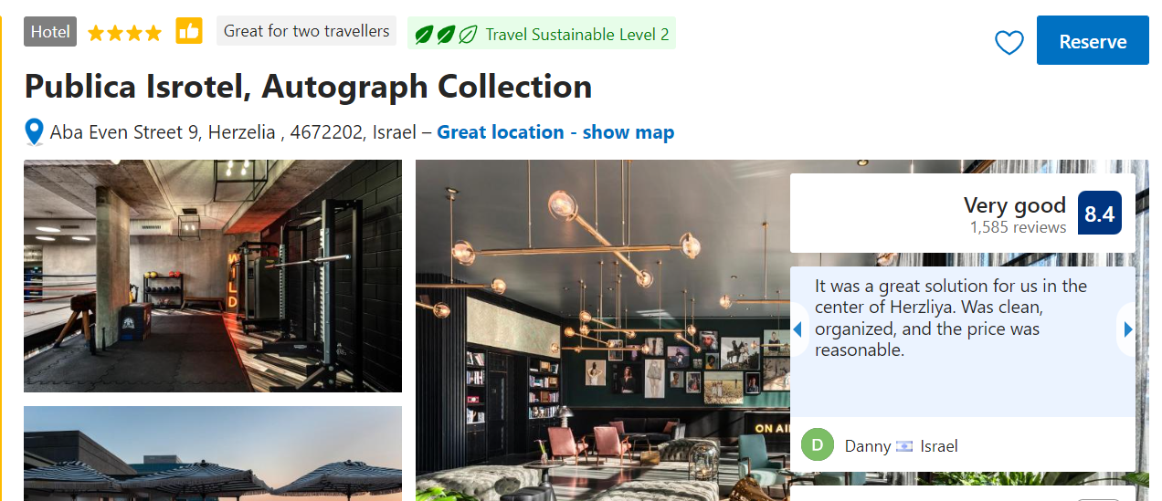
Agenda
Our research question
About us
We decided to check whether it is possible to predict whether a hotel will succeed ( get a high rating by the booking website) given Analysis of parameters from the booking.com based on hotels with similar characteristics.
Example of parameters: city name, distance from the city center.
We are two good friends who really like to travel. When we chose hotels, we knew that we could always rely on the opinions of previous visitors to choose the best hotel for us. Like us, many people use feedback, which can affect the success or lack of success of a hotel.
For example: if I arrive at a hotel and receive good service, I will leave positive feedback when a traveler sees my feedback along with options that the hotel offers, he can decide whether it is worth investing his money in a room in this hotel

Slide 3

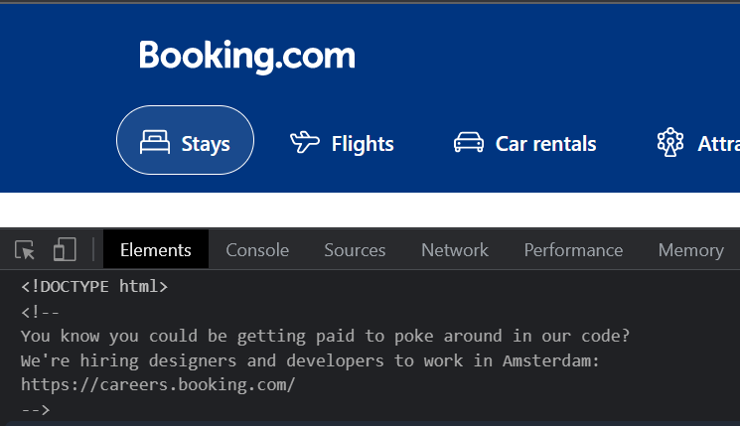

Data-Acquisition
Web crawling
And we started scraping
But booking is smarter

Slide 4
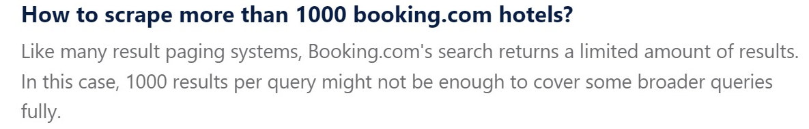

We found that booking is protected site that don’t share its information easily.
So, we started looking for another option.
We found a great website that allows us to get its information.

Slide 5

Data acquisition

Slide 6

Crawling
Crawling – using ‘Beautiful Soup’ library we performed the crawling stage.
In-order to get all the data we needed, we had to write a function to crawl and save all the relevant data to csv file.
The function works as follows:
It gets number of pages we want do check in specific city.
From the inspect we get string that contains the next page URL.

Slide 7

Data acquisition
We saved hotel names and URLS in csv file.
Including information such as :
Number of reviews , TripAdvisor rating , Rating regarding other hotels in the same city , Location rating , Cleanliness rating , Service rating , Value of money , Paid private parking nearby , Free high-speed Wi-Fi , Fitness center , Air conditioning , Minibar , Cable satellite TV , 24-hour front desk , Non-smoking hotel , Express check-in, check-out , Baggage storage , Housekeeping , Safe , Family rooms .

Slide 8
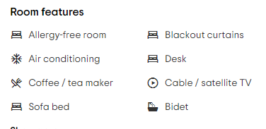
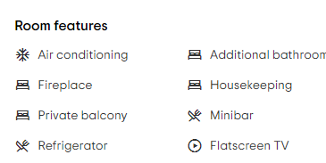

Hotel X :
Scraping hotel features
Scrapping the features:
In every hotel the Room features are not the same. For example : hotel X has a ‘Allergy-free room’ hotel Y don’t.
For every existing feature we entered the value ‘1’ otherwise we entered ‘0’.
Hotel Y :

Slide 9
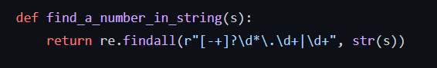
Getting numbers
For the crawling process we needed to get decimal information from String. This function uses regular expression to find numeric values in string.
The regular expression looks for:
Optional leading plus or minus sign indicated by ‘[-+]?’.
Optionally, any number of digits indicated by ‘\d*’ .
A literal period indicated by ‘\.’.
At least one digit indicated by ‘\d+’.

Slide 10
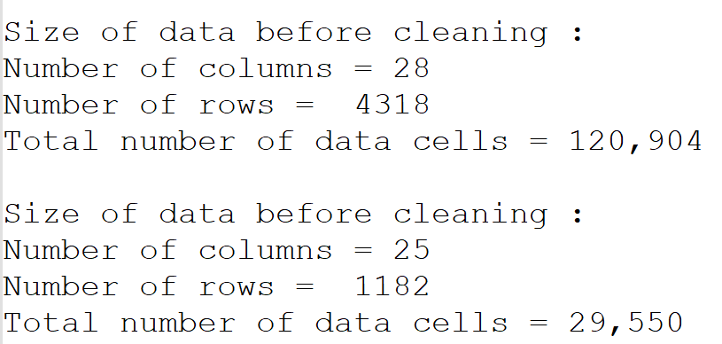

Data Cleaning

Slide 11

Data cleaning
After scraping we continued to data acquisition and cleaning phase:
Remove duplicates while leaving only first copy.
Removing corrupt rows containing at least one empty value.
Removing rows that contain outlier data.
Data Cleaning
Cleaning, formatting, and filtering data.

Slide 12
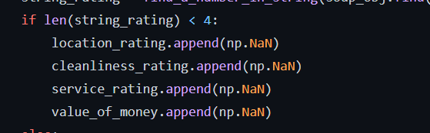
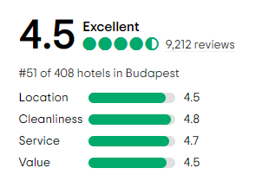
Data cleaning - missing values
We had some missing parameters while collecting the grades from ‘Location’, ‘Cleanliness’, ‘Service’, ‘Value’.
In some hotel URL’S we found that one or more of these category was missing.
In this case we added Nan value.

Slide 13
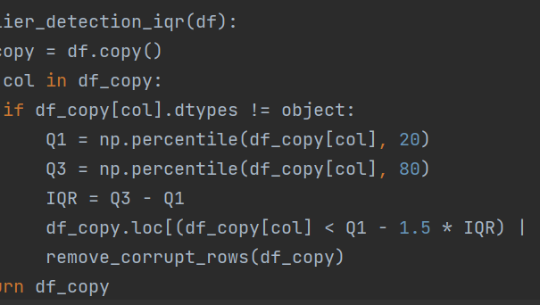
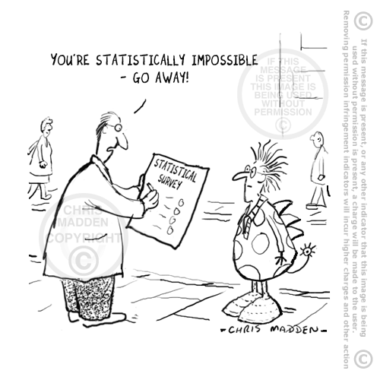
Data cleaning – outliers
After working on the data, we noticed that some of the values in TripAdvisor rating column seemed to be too low to be true. In-order to make our data more accurate, we used outlier detection iqr function.
Notes:
לתקן

Slide 14
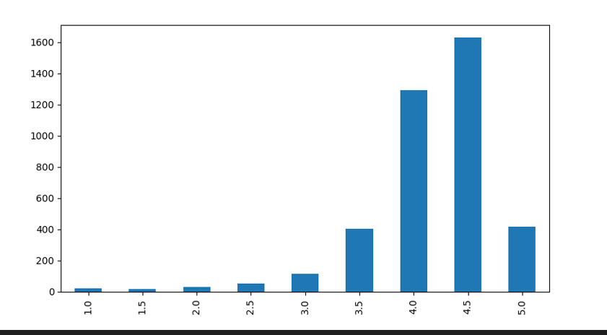
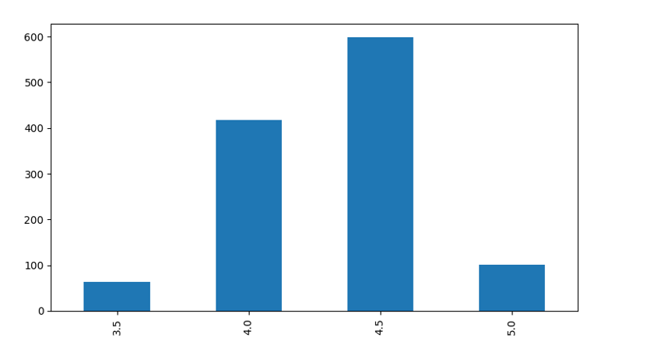
Normalize data
1
Like any other business, TripAdvisor website wants customers to continue making purchases.
It thins out and removes hotels that are considered low quality.
As you can see in the first chart there are very few hotels with rating lower than 3.5. In order to be published on TripAdvisor website these hotels are required to stand in specific standards.
We handled this abnormal data by removing those hotels that are candidates for removal from the site and are not relevant to us.
2
Notes:
לתקן

Slide 15

EDA
Visualizing and understanding the data

Slide 16
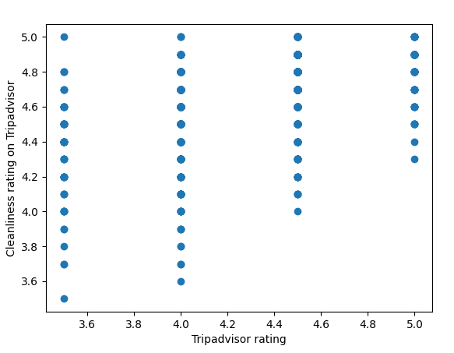
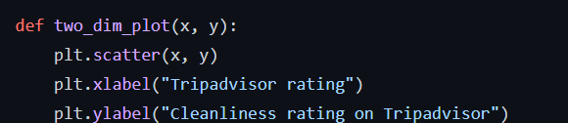
EDA – influence of cleaning on rating
In this diagram we can see the cleaning service rating influence of on TripAdvisor rating.
As the minimum cleanness score is higher, the TripAdvisor rating is higher.

Slide 17
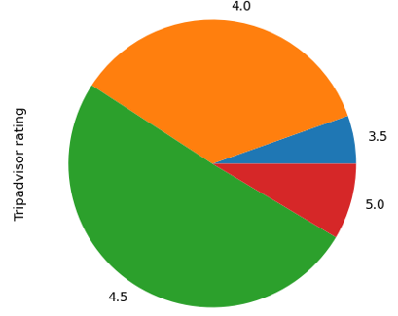
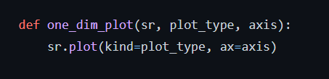
EDA – Hotels rating pie
So.. What am I looking at?
A pie chart which was created using matplotlib.pyplot library.
It shows the partition of grades between different hotels that exist in our data frame.

Slide 18
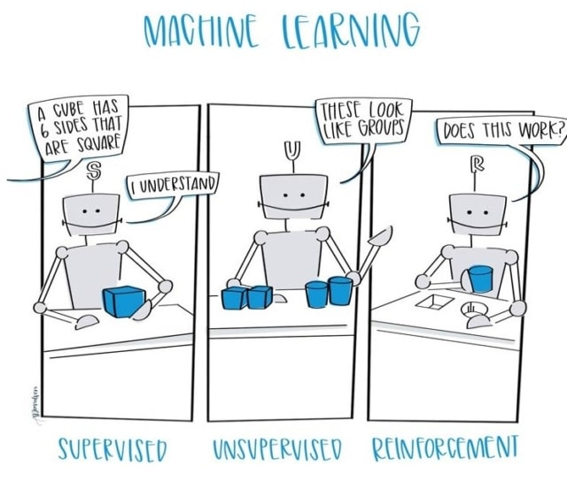
Machine Learning
Create final prediction model
Machine Learning

Slide 19
Intro
While scraping the data we just couldn't ignore the number of responses people write about their experience from the hotel, so we thought how to use them.
We noticed that in every comment people express feelings like "perfect" "good" or alternatively "disappointed“. We realized that when they give their numerical rating, it doesn't always match how they define their feeling in the comment. For example: person who was very upset from the hotel in his comment gave the grade 4.0.
So, we counted from scraping examples of words such as: “good” and “bad” and summed them. For every good connotation word, we added score of 1. For every bad connotation word, we subtracted score of 1. So, if you see that in our column of total grade has 0 maybe you shouldn't reserve this hotel .

Slide 20

Choosing predicting Algorithm
When we had to choose the right algorithm for our prediction, we immediately knew that we had to turn to supervised learning because all the categories in our case are known in advance meaning distribution of TripAdvisor rating grades.
But when we wanted to choose between : 1. Classification problem. 2. Regression problem. We encountered a dilemma.
On the one hand the numbers we work with categorial numbers, but on the other hand we work with constant numbers.
Therefore, we realized that we must go to the label of categorical numbers.

Slide 21
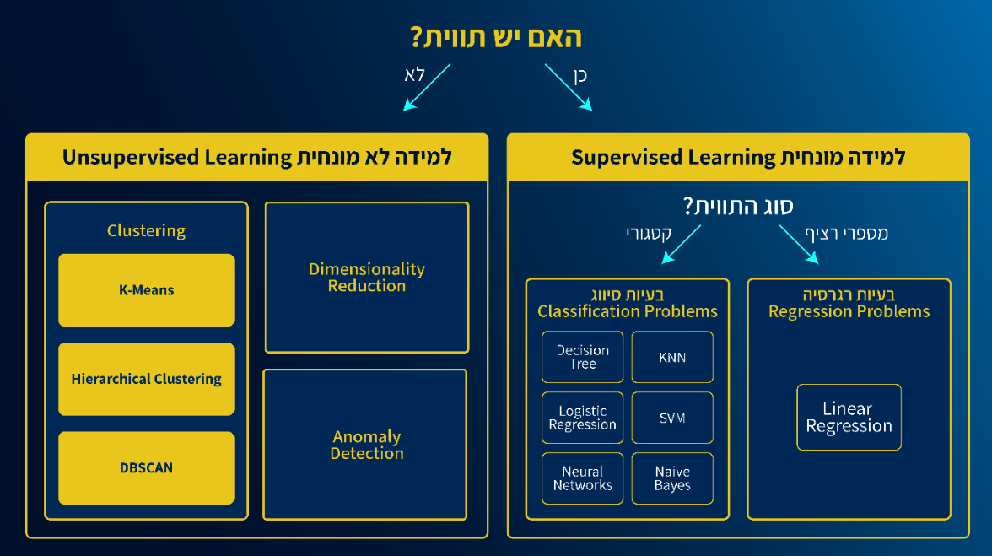


Slide 22

Predicting algorithms
In order to achieve the best result, we used 4 machine learning algorithms, and these are the results we received:

Slide 23
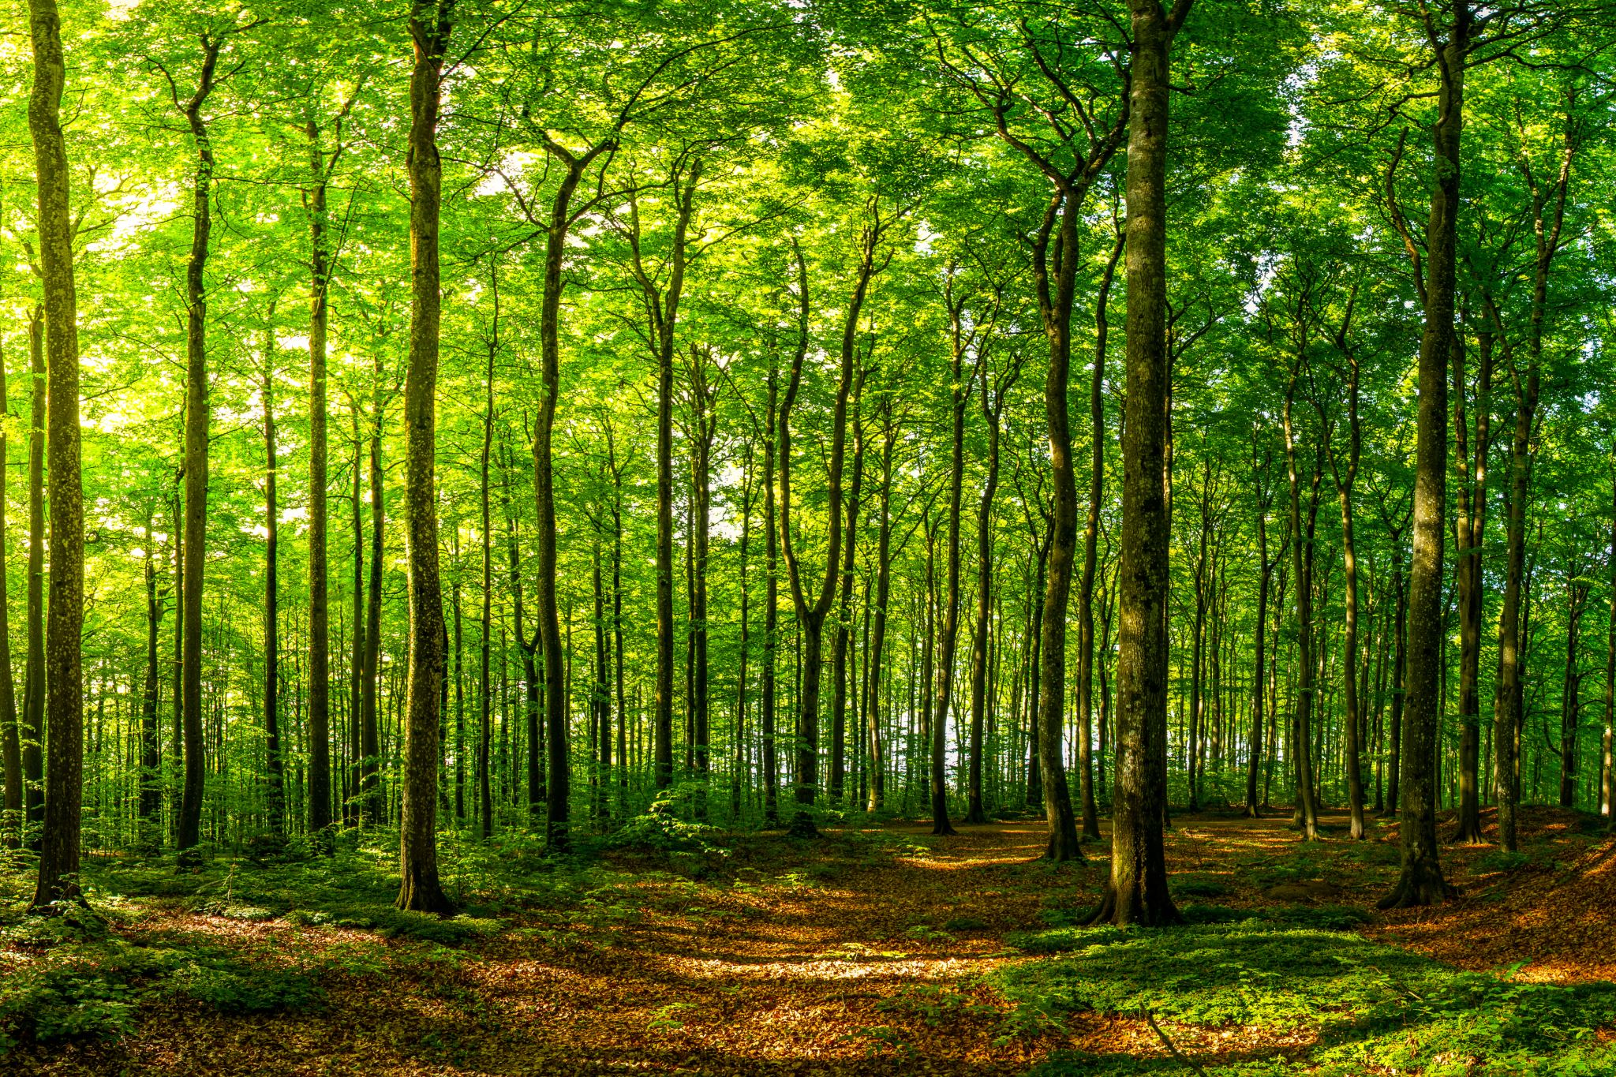
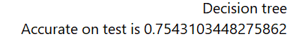
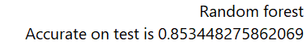
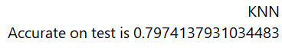
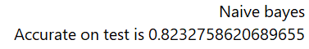
Machine learning –
choosing algorithms
We got the best results in random forest algorithm.

Slide 24
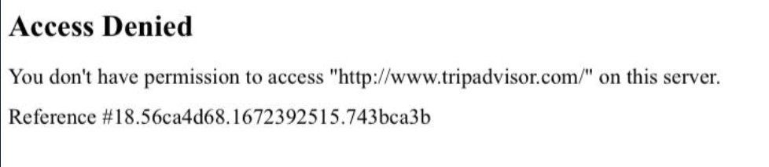

No more TripAdvisor for Ofir
After scraping the data without adding 10 seconds of sleep in between commands as we been told in class. Ofir got an Access Denied screen.

Slide 25


Thank you

